Slide 1

TASK 1 · FOUNDATIONAL SETUP & EDA
E-commerce Sales Dataset
Exploratory Data Analysis Walkthrough
Kritika kapoor
4,864 orders analyzed · 1,690 customers · Jan 2024 – Jun 2025
Apexplanet Data Analytics Internship

Slide 2




What This Deck Covers
Task 1 objective: set up the analytics environment, understand the data source, clean it, and surface initial insights.
1. The Dataset
2. Cleaning It Up
3. Exploring the Data
4. Key Findings
Where it came from, what it contains, and its scope.
Missing values, duplicates, wrong types, and outliers.
Univariate and bivariate patterns across the dataset.
What the numbers say about revenue, customers, and behavior.
Apexplanet · Task 1 — E-commerce Sales EDA
2

Slide 3




Dataset at a Glance
An order-level e-commerce sales dataset spanning 18 months across 7 product categories and 5 regions.
4,864
1,690
$1.11M
Orders (cleaned)
Unique customers
Total revenue
7
$228
18 mo.
Product categories
Avg. order value
Jan 2024 – Jun 2025
Apexplanet · Task 1 — E-commerce Sales EDA
3

Slide 4

Data Source & Structure
Column | Description
order_id / order_date | Unique order ID and purchase date
customer_id / age / gender | Customer identifiers and demographics
product_category | One of 7 categories purchased
unit_price / quantity | Price per unit and units ordered
discount_percent / revenue | Discount applied and net order revenue
region / payment_method | Customer region and payment channel
customer_rating | Post-purchase rating, 1-5 (often missing)
A note on sourcing
No dataset file was supplied for this task, and this environment has no internet access to pull a real dataset from Kaggle. A realistic synthetic e-commerce sales dataset was generated instead — with genuine data-quality issues (missing values, duplicates, inconsistent text, wrong types, outliers) built in, so the cleaning work shown next is solving real problems.
Swap in a real CSV (Kaggle / company data) and re-run the notebook to analyze actual data.
Apexplanet · Task 1 — E-commerce Sales EDA
4

Slide 5

Cleaning the Data
Raw data had real quality issues — here's how each was resolved before analysis.
Standardize columns
Remove duplicates
snake_case naming across all 14 columns
40 exact duplicate rows dropped
Fix data types
Clean text
order_date → datetime; categories → category dtype
Inconsistent casing/whitespace normalized
Impute missing values
Flag missing ratings
Median for numeric, mode for categorical (241 + 226 values)
Left as NaN with a rating_missing indicator (511 orders)
Cap outliers (IQR)
Drop invalid rows
Extreme ages and 15–40x revenue spikes winsorized
Biologically implausible ages (<13) removed
Apexplanet · Task 1 — E-commerce Sales EDA
5

Slide 6
Electronics Drives Revenue
Total revenue by product category — despite fewer orders than Clothing, Electronics leads by a wide margin.
52%
of total revenue comes from Electronics alone
Electronics has only ~22% of order volume — high unit price, not order count, drives its lead.
Apexplanet · Task 1 — E-commerce Sales EDA
6

Slide 7
Orders and Regions Are Balanced
Order volume skews slightly toward Electronics/Clothing; revenue is spread evenly across regions.
Apexplanet · Task 1 — E-commerce Sales EDA
7

Slide 8
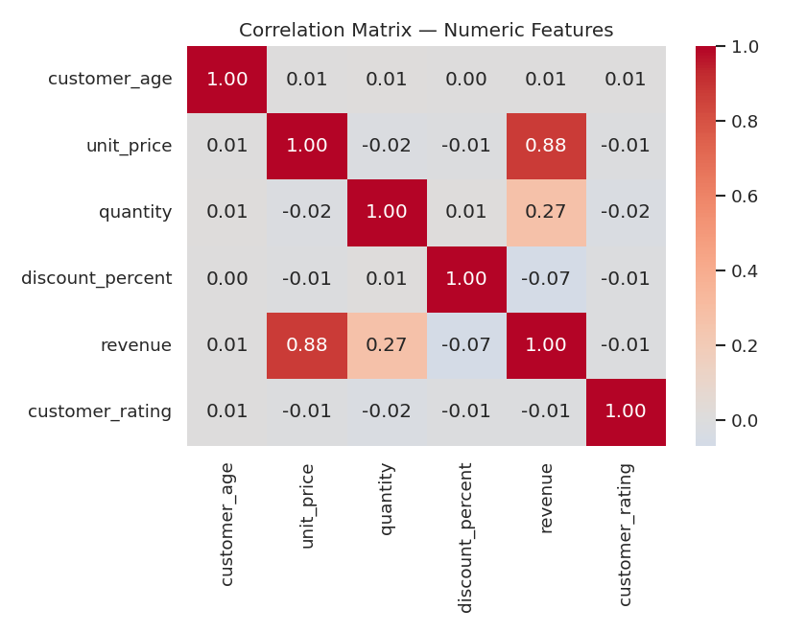
What Predicts Revenue?
Correlation matrix across numeric features — unit price is by far the strongest driver of order revenue.
0.88
Correlation between unit price and order revenue — the strongest relationship in the dataset.
0.27
Correlation between quantity and revenue — a moderate, secondary driver.
-0.07
Discount percent has almost no linear relationship with per-order revenue.
Apexplanet · Task 1 — E-commerce Sales EDA
8

Slide 9
Revenue Is Stable Over Time
Monthly revenue across the full 18-month window shows healthy fluctuation, not a seasonal or declining pattern.
Apexplanet · Task 1 — E-commerce Sales EDA
9

Slide 10


How Customers Pay — and Rate
Credit card leads payment share; roughly 1 in 10 orders is left unrated.
4.0 / 5
Average customer rating (rated orders)
10.2% of orders have no rating at all — flagged rather than imputed, since a missing rating is meaningfully different from a bad one.
51.5%
of orders include a discount
Discounting is common but has little effect on per-order revenue (corr. -0.07) — it may be more about conversion than order size.
Apexplanet · Task 1 — E-commerce Sales EDA
10

Slide 11
Key Findings
What the exploratory analysis tells us so far
1
Electronics leads on revenue, not volume
2
Unit price is the strongest revenue driver
High unit price outweighs lower order count — 52% of revenue from ~22% of orders.
0.88 correlation with revenue; quantity and discount play smaller roles.
3
Revenue outliers needed correcting
4
~10% of orders go unrated
A handful of orders were 15–40x normal size — capped via IQR before analysis.
Worth investigating operationally — shipping mode or payment method may be a factor.
5
Revenue is steady, not seasonal
6
Regions are evenly matched
18 months of data show healthy month-to-month variation without a clear trend.
Revenue spread across Central/South/North/West/East is within ~9% of each other.
Apexplanet · Task 1 — E-commerce Sales EDA
11
11

Slide 12
Deliverables & Next Steps
Delivered in Task 1
Next Up
GitHub-ready repo: notebook + cleaned dataset + README
Build a Power BI / Tableau dashboard from the cleaned dataset
Cleaned dataset saved to data/processed/
Investigate the ratings-missing pattern by shipping mode
7 exported charts saved to reports/
Layer in a real dataset if/when one becomes available
Cleaning log documenting every transformation
Apexplanet · Task 1 — E-commerce Sales EDA
12

